Slide 1


Master of Science in Applied Data Science Portfolio Milestone Spring 2024
Blessy A. Thomas
SUID#: 520121045
Bthoma16@syr.edu
Notes:
Hello, my name is Blessy Thomas, and I am a Spring 2024 graduate
Today I will discuss my Portfolio Milestone for the Master of Science in Applied Data Science program here at the School of Information Studies at Syracuse University

Slide 2
Introduction
Academic Journey Overview
Illustrates the transition from a biology background to data science and the impact of the program on professional growth
Project Significance
Emphasizes the importance of projects and courses in shaping skills and knowledge in data science
IST 659: Data Administration Concepts & Management
IST 707: Applied Machine Learning
IST 652: Scripting for Data Analysis
IST 664: Natural Language Processing
Personal Growth
Reflects on the personal development experienced throughout the program and its impact on future career prospects
Notes:
In this presentation, I'm excited to share with you the journey I've embarked upon through my academic career, specifically highlighting my experiences and growth within the Master of Science in Applied Data Science program at Syracuse University
This portfolio not only represents my academic achievements but also marks a significant personal transition from a background in biology to the field of data science
My academic path began with a Bachelor of Science in Biological Sciences from SUNY Old Westbury in 2021
Initially, I aspired to work in healthcare either as a physical therapist or physician assistant
However, as I delved deeper into my undergraduate studies, I discovered a passion for technology and data
This revelation was the catalyst for my decision to pivot towards a career in data science, leading me to apply to this program
Transitioning from biology to data science had its challenges. Yet, the journey has been immensely rewarding. This program played a pivotal role in this transition. It not only deepened my understanding of data science but also equipped me with a versatile skill set, preparing me to tackle real-world data-driven challenges across any sector
Throughout my time in the program, I engaged in a comprehensive curriculum that significantly enhanced my expertise in data science
I had the opportunity to undertake a variety of courses, each contributing uniquely to my skill set and understanding of the field
In IST 659: Data Administration Concepts & Management, I built a strong foundation in SQL and database management
IST 707: Applied Machine Learning introduced me to R programming, where I learned to construct and apply machine learning models
IST 652: Scripting for Data Analysis allowed me to refine my Python skills, furthering my ability to perform effective data analysis
Lastly, IST 664: Natural Language Processing expanded my proficiency in Python, specifically for processing and analyzing human language data, opening new avenues for exploration in the field of data science
This portfolio is more than just a collection of courses and projects; it's a narrative of transformation, learning, and aspiration
It reflects my journey from a student of biology to a budding data scientist, ready to make meaningful contributions to the world of technology and data

Slide 3
Introduction (Cont.)
As an interdisciplinary program, the Master’s in Applied Data Science provides students the opportunity to learn in a broad range of areas related to data science. Successful students in the program will be able to:
Collect, store, and access data by identifying and leveraging applicable technologies
Create actionable insight across a range of contexts (e.g. societal, business, political), using data and the full data science life cycle
Apply visualization and predictive models to help generate actionable insight
Use programming languages such as R and Python to support the generation of actionable insight
Communicate insights gained via visualization and analytics to a broad range of audiences (including project sponsors and technical team leads
Apply ethics in the development, use and evaluation of data and predictive models (e.g., fairness, bias, transparency, privacy)
Notes:
As a graduate of the program, I am confident in my ability to achieve the following six learning outcomes:
Collect, store, and access data using appropriate technologies
Create actionable insights across various contexts, such as societal, business, and political, using data and the full data science life cycle
Apply visualization and predictive models to generate actionable insights
Utilize programming languages such as R and Python to support the generation of actionable insights
Communicate insights effectively to a wide range of audiences, including project sponsors and technical team leads
Apply ethics in the development, use, and evaluation of data and predictive models, considering factors such as fairness, bias, transparency, and privacy
Throughout my portfolio, I will provide examples of how I have successfully met these learning outcomes through the projects I completed in the courses I mentioned earlier

Slide 4

IST 659: Data Administration Concepts & Management
Inventory management database
Notes:
In the course IST 659, Data Administration Concepts & Management, a course under the guidance of Mr. Chad Harper, we were presented with the challenge of designing and implementing a functional system, inclusive of a database, aimed at solving a real-world problem
As part of our project for this course, my team and I took the initiative to develop a sophisticated inventory management database system

Slide 5
IST 659: Data Administration Concepts & Management
Course Project Overview
Designed and implemented a relational database for Whole-ER Foods to optimize inventory management
Challenges in Inventory Management
Utilized SQL to address issues related to inventory tracking and consumer demand fluctuations
Data-Driven Solutions
Implemented data administration concepts to enhance operational efficiency and decision-making processes
Notes:
Our journey began with the task of creating a relational database for a conceptual grocery store named Whole-ER Foods
This store, despite its noble commitment to eco-friendliness and health-oriented products, found itself grappling with the challenge of maintaining its foothold in the competitive market
The allure of Whole-ER Foods' product range was undeniable, yet the store encountered significant hurdles in fulfilling the demand from its customer base
Traditionally, Whole-ER Foods replenished its inventory on a weekly basis, every Friday, sourcing products in bulk from a dedicated supplier
The store's inventory management was initially orchestrated through Microsoft Excel, a method that soon proved inadequate for their growing needs
The crux of our project was to facilitate Whole-ER Foods' transition towards a more sophisticated relational database system
This strategic move was aimed at refining their inventory management processes, thereby better aligning with consumer expectations—a challenge not unique to Whole-ER Foods but prevalent across the grocery retail sector
As we delved into the development phase, we decided to narrow our focus to key areas: product inventory, shipments, transactions, and customer interactions. This decision was pivotal in managing the project's scope effectively
To populate our database with realistic data, we worked on gathering fictional yet plausible information
This involved simulating store audits, analyzing warehouse receipts, scrutinizing invoices, reviewing point-of-sale (POS) data, and examining purchase orders
The data categories we concentrated on included an array of essential elements such as products, vendors, orders, and transactions
This meticulous approach was instrumental in ensuring the database's relevance and utility for hypothetical scenarios akin to those faced by Whole-ER Foods

Slide 6
Database Design and Implementation
Database Design
Development of logical and conceptual models for efficient data storage and retrieval
Relational Models
Implementation of relationships between database tables to ensure data integrity and consistency
Azure Data Studio and SQL Server
Utilization of Azure Data Studio for database development and management, and Microsoft SQL Server for data storage and querying
SQL for Inventory Management
Implementation of SQL queries to optimize inventory control, streamline data retrieval, and ensure accurate inventory records
Notes:
To effectively manage the data relationships among various entities, we constructed both conceptual and logical models for efficient data storage and retrieval, which you can see on the following slide
To facilitate data population and analysis, we utilized Azure Data Studio in conjunction with Microsoft SQL Server to establish tables
Furthermore, we implemented relationships between the database tables to ensure data integrity and consistency
By leveraging Azure Data Studio and Microsoft SQL Server, we were able to optimize inventory control, streamline data retrieval, and maintain accurate inventory records

Slide 7
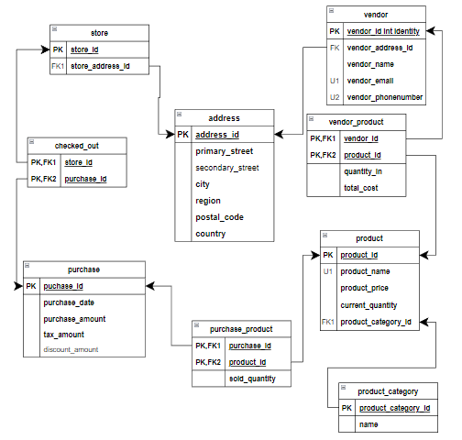
Figure 1: Logical Model
Notes:
Figure 1 illustrates the logical framework we've crafted to orchestrate the intricate web of data associations between various entities within our system
In this model, you'll notice that we've established primary keys as the pillars of our database architecture
These keys are symbolized by arrows, signifying the pathways that interlink our tables
To navigate through this structured data landscape, one would utilize these primary keys as conduits
For instance, if you wish to move from the 'Address' table to the 'Vendor_Product' table, you would start at 'address_id', proceed to 'vendor_address_id', and culminate at 'vendor_id’
This approach ensures a seamless and coherent flow of information across our database, enabling us to maintain data integrity and facilitate efficient data retrieval

Slide 8
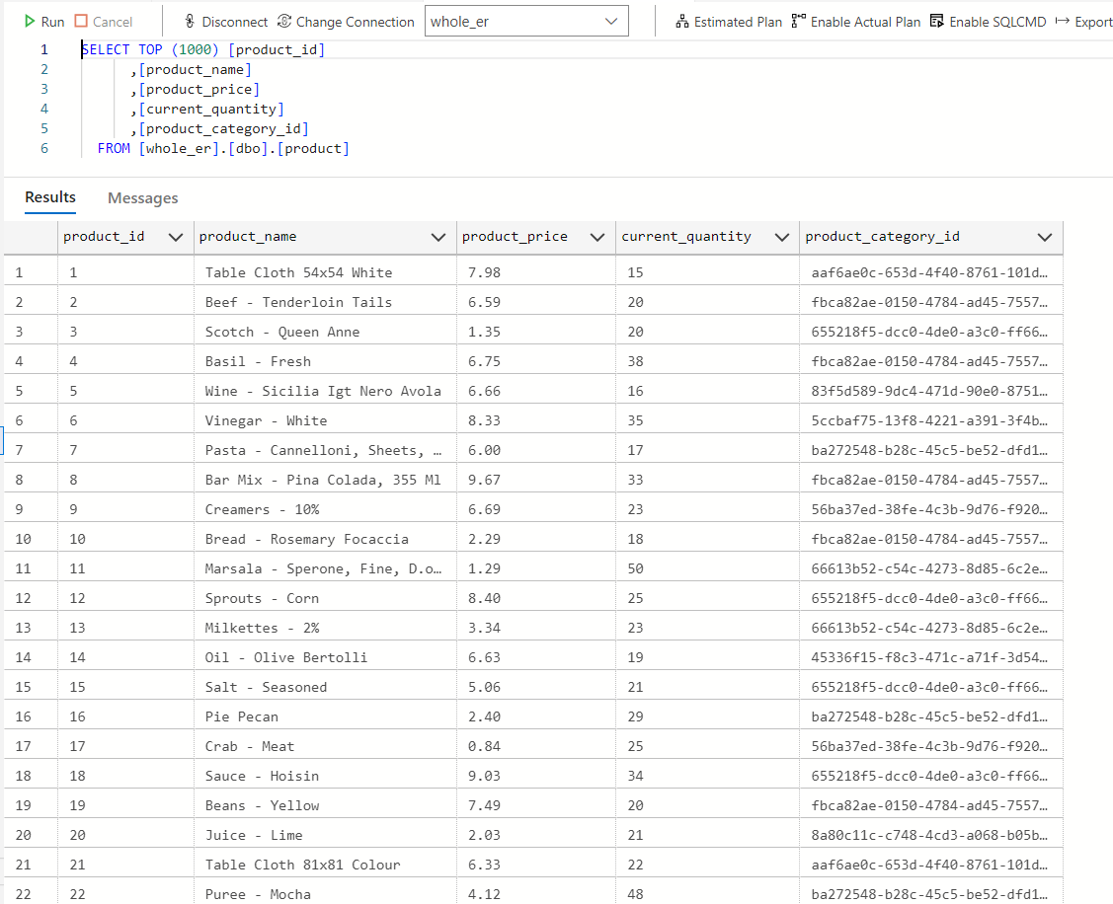
Figure 2: Relational Database
Notes:
As you can see in Figure 2, we have developed a relational database tailored to needs of Whole-ER Foods
This figure illustrates the implementation of stored procedures that efficiently fetch and display essential product details such as names, prices, quantities, and their respective IDs and categories
The database design includes a convenient search feature, allowing us to quickly locate products by their product_id and product_category_id, streamlining their inventory management
These carefully chosen data fields are key for Whole-ER Foods, providing valuable insights into their stock levels and product availability to ensure they consistently meet their customers' expectations

Slide 9
Real-World Application and Learning Outcomes
Real-World Challenges Preparation
The project provides hands-on experience in developing relational databases for practical applications
Students gain insights into data management and SQL usage, essential for database administration roles
Understanding of inventory management challenges and solutions in a real-world context
Alignment of Program Objectives
Emphasis on database design principles enhances students' understanding of structured data storage and retrieval
Focus on ethical data handling instills a sense of responsibility in managing sensitive information
Notes:
This project was a deep dive into the world of relational databases, designed to mirror the complex issues faced by grocery retailers
It was an invaluable experience, teaching me how to design and implement solutions for real-world business problems
The journey from using basic Excel for inventory management to SQL for a relational database was transformative. It taught me the intricacies of managing inventory and understanding consumer demand, skills crucial for anyone in the retail industry
Throughout this project, I refined my ability to create data models, a fundamental step in managing the relationships between different data entities. Using tools like Azure Data Studio and Microsoft SQL Server, I was able to bring these models to life and lay a solid foundation for the database
Learning to create stored procedures was another highlight that improved my data analysis skills. This ability to efficiently retrieve and analyze data is something I now consider an essential tool in my skillset
Beyond the technical skills, this project prepared me for future challenges in data administration, giving me a comprehensive understanding of the field
By handling data collection, storage, and retrieval using advanced technologies, the project not only achieved its goals but also marked a significant step forward from the initial Excel-based approach
Focusing on a fictional grocery retailer, Whole-ER Foods, the project provided practical insights into enhancing inventory management and meeting customer demands, using a data-driven approach
Implementing search functionality based on product identifiers was a practical solution that improved Whole-ER Foods' ability to manage stock levels and product availability efficiently
A key principle of this project was the ethical use of data. By choosing to work with fictional data, we navigated important ethical considerations, ensuring fairness, transparency, and privacy were maintained, highlighting the importance of ethical decision-making in data use

Slide 10


IST 707: Applied Machine Learning
Student grade prediction
Notes:
In the course IST 707: Applied Machine Learning, under the guidance of Dr. Jeremy Bolton, we were immersed in a hands-on project that addressed a tangible challenge within the field of data mining
During our course project, my team members and I employed sophisticated data mining methods with the objective of forecasting student academic performance

Slide 11
IST 707: Applied Machine Learning
Course Project Overview
Applying machine learning techniques to analyze Kaggle data and identify at-risk high school students requiring academic support
Machine Learning Application
Utilizing RStudio and algorithms to predict and classify students based on data patterns and indicators of support needs that contribute to student failures for proactive intervention
Data-Driven Solutions
Implemented machine learning techniques to tailor recommendations and provide insights for improvement
Notes:
We utilized a dataset from Kaggle, which included 33 variables across 395 student entries
The dataset captured student performance over three terms, demographic information, and a range of social and school-related factors
The project addressed a significant challenge: the difficulty schools face in identifying students who need additional support in a timely manner
Two Portuguese schools with similar characteristics in terms of class size, curriculum, and instructional hours undertook this analysis, focusing on high school mathematics students
Our objective was to identify factors contributing to student underperformance and to develop strategies for early identification and intervention for students at risk, especially those with grades below 55%
A binary indicator was employed in the study to facilitate the analysis, marking grades at or below 55% with a '1' and grades above this threshold with a '0'

Slide 12
Machine Learning Techniques and Models
Applied Data Analysis Techniques
Utilized decision tree, logistic regression, SVM, and random forests, etc. in data analysis
Accuracy and Precision
Focused on enhancing model accuracy and precision in predictions
Insights
Tailored recommendations for schools based on the insights derived from the machine learning models
Notes:
We began by cleaning and preparing our data with R Studio, ensuring a solid foundation for the analysis
A refined data set was created, spotlighting the 10 most influential variables identified through feature importance
Our exploratory data analysis revealed key insights, which will be discussed on the following slide
Armed with our initial observations, we applied a suite of analytical techniques, including decision trees, logistic regression, k-nearest neighbors, association rule mining, support vector machines, and random forests, to delve deeper into the problem
We evaluated three logistic regression models, each using the top ten influential variables
The first model proved to be the most precise, with an accuracy of 71.74%
The k-NN method, with k set to 11 and also focusing on the top variables, achieved an accuracy of 68.84%
The outcomes of the decision tree, SVM, and random forest models will be detailed in the upcoming slides
The random forest model stood out for its accuracy, though we're mindful of potential overfitting, with the SVM also showing strong predictive capabilities
To better support students at the two Portuguese schools, we recommend considering the random forest model, carefully calibrated to avoid overfitting, and paying close attention to the ten key variables: failures, freetime, fedu, dalc, walc, schoolsup, absences, age, famrel, and famsize, which have a significant impact on students' final grades

Slide 13
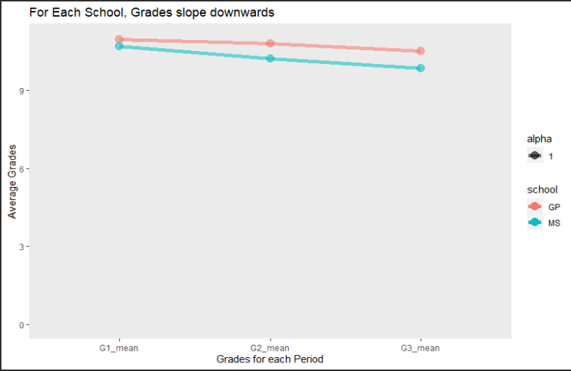
Figure 3: Decrease in Grades as the Academic Year Progressed (EDA)
Notes:
Upon examining Figure 3, it became apparent that as the academic year progressed, there was a noticeable downturn in academic performance within both schools under study
This was coupled with a concerning rise in the number of students receiving scores of zero
In our analysis, we observed a subtle yet consistent trend: on average, male students achieved slightly higher grades than their female counterparts across both educational institutions
Interestingly, the data revealed a comparable rate of failure among students in both schools
This suggests that the school environment might not play a pivotal role in student success
Lastly, it's worth noting that investing in extra tuition did not seem to correlate with better academic outcomes
This finding challenges the assumption that additional classes are a surefire way to enhance student performance

Slide 14
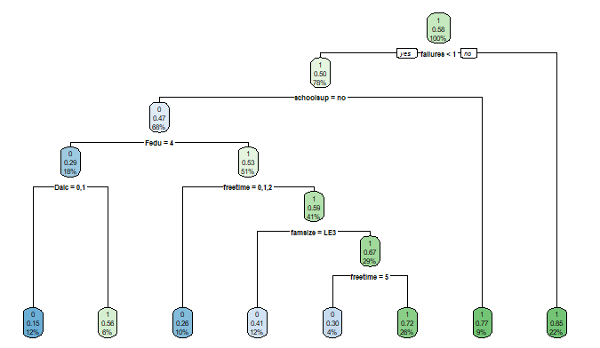
Figure 4: Decision Tree Model
Notes:
Figure 4 displays the initial decision tree, which, despite its visual clutter, performed slightly better than the no information rate, which assumed all students failed
After pruning and evaluating feature importance, the accuracy of the decision tree increased by 12.46% to 74.64%

Slide 15
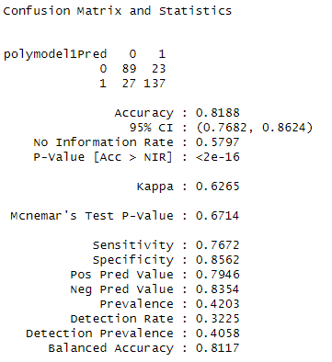
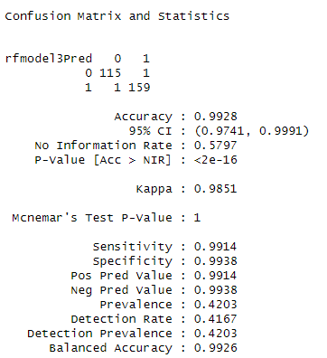
Figure 5: SVM Model
Figure 6: Random Forest Model
Notes:
In figure 5, we observe the performance of a Support Vector Machine (SVM) model
This model, carefully fine-tuned with a radial basis function kernel and a cost parameter set at 0.95, demonstrates a commendable accuracy of 81.88%
It's important to note that this result was achieved by leveraging the same subset of variables previously discussed
Moving on to Figure 6, we delve into the outcomes produced by employing a random forest algorithm
By setting the number of trees at 500 and the number of variables tried at each split at 4, all while utilizing the top ten variables, we were able to achieve an unparalleled accuracy of 99.28%
However, it's crucial to approach this result with a degree of caution, as such a high accuracy level may signal the presence of overfitting within our model

Slide 16
Real-World Application and Learning Outcomes
Real-World Challenges Preparation
Students gain hands-on experience in the data science lifecycle through data collection, cleaning, analysis, and interpretation
The project involves thorough model evaluation to assess the performance and effectiveness of machine learning algorithms
Alignment of Program Objectives
Emphasis on ethical considerations in machine learning practices, ensuring fairness, transparency, and accountability in data-driven decision-making
Addressing biases and promoting responsible use of data in machine learning applications
Notes:
The project served as a comprehensive introduction to the data science lifecycle, offering me a hands-on experience that spanned from data preprocessing all the way to model evaluation
This journey provided a solid foundation for tackling real-world data science challenges
By focusing on a practical issue—identifying students who might need additional support—we mirrored the type of challenges often encountered in professional settings
A significant portion of the project was dedicated to the thoughtful selection of models and the ethical considerations inherent in machine learning
We delved into the importance of avoiding overfitting and ensuring the responsible use of technology, skills that are crucial for any data scientist
The project began by addressing the first learning goal, showcasing our ability to collect, store, and access data
We utilized a Kaggle dataset, which we then cleaned and pre-processed using R Studio
Our analysis of student performance data, aimed at identifying at-risk students, directly contributed to the second learning goal by creating actionable insights
The application of visualization and predictive modeling techniques, including decision trees and logistic regression, fulfilled the third learning goal
The use of R programming language throughout the project not only supported our analysis but also met the fourth learning goal
Lastly, our focus on ethical model development, particularly our approach to mitigating overfitting in the random forest model, touched upon the sixth learning goal related to ethics

Slide 17

IST 652: Scripting for Data Analysis
Analyzing company attrition
Notes:
In the course IST 652: Scripting for Data Analysis, Dr. Gregory Block challenged us to showcase our Python scripting skills
We gathered and analyzed data from various sources, both structured and unstructured
We chose a specific research topic, collected relevant data, and created summaries, structures, and visualizations
For our project, my team and I analyzed company attrition
This project helped us apply our skills in a real-world scenario and understand the factors influencing employee turnover

Slide 18
IST 652: Scripting for Data Analysis
Course Project Overview
Demonstrating proficiency in Python scripting for data analysis on a Kaggle HR analytics dataset, emphasizing employee attrition as the main focus
Employee Turnover Strategies
Focused approach on devising effective strategies to mitigate employee turnover rates based on data-driven insights
Data Analysis Impact
Emphasizing the importance of data analysis techniques in understanding patterns related to employee attrition as well as identifying key factors leading to employee attrition and making informed decisions to enhance employee retention and organizational performance
Notes:
We delved into a HR analytics dataset from Kaggle, encompassing 38 distinct variables
This dataset provided a comprehensive look into various aspects of the workforce, including gender, departmental affiliations, educational backgrounds, roles, and monthly income levels across the company
Our investigative spotlight was cast on the critical 'Attrition' variable
This key indicator sheds light on an employee's current status within the company, distinguishing between those who have chosen to depart and those who continue to work
The essence of our analysis was to unearth valuable insights into the dynamics of human resource analytics and the overarching organizational culture
Our goal was not just to explore but to pave the way toward actionable strategies aimed at curtailing employee turnover. This is a concern, as turnover not only disrupts but also incurs significant costs for any organization
Through examination of the data, we were able to pinpoint several pivotal factors that play a role in employee attrition
This understanding has been instrumental in formulating potential measures designed to mitigate such challenges, thereby fostering a more stable and thriving work environment

Slide 19
Predictive Modeling and Insights
Attrition Rates by Age Group
Analysis of attrition rates categorized by different age groups within the organization
Impact of Travel on Retention
Evaluation of how travel requirements affect employee retention and job satisfaction
Retention of Top Performers
Examination of strategies to retain high-performing employees and the correlation with business success
Turnover Prediction
Creation of a predictive model for forecasting employee turnover
Notes:
In our data analysis project, we leveraged Python for data cleaning, pre-processing, and comprehensive analysis within the Jupyter Notebook and Google Colaboratory platforms
Our exploration was guided by three pivotal questions concerning employee retention across different age groups, the effects of travel on employee loyalty, and the persistence of our top performers within the company
The Python libraries pandas, matplotlib.pyplot, and numpy were instrumental in streamlining this process
The subsequent slides will detail our findings, which highlight the company's commendable retention rate of over 80% for top talent
The analysis also brought to light a higher turnover rate among employees who travel frequently, suggesting the need for the company to consider implementing measures such as additional rest periods or regional travel assignments to alleviate burnout
Additionally, the data pointed to a trend of younger employees seeking opportunities elsewhere
To address this, the human resources department might look into incentives like faster PTO accrual or educational benefits to enhance retention for this demographic
It is also important to recognize the ethical implications of this analysis
It is intended to be a tool for supporting and improving the satisfaction of the current employees, not for influencing hiring decisions
Any misuse of this data in hiring practices could have serious moral and legal consequences for the company

Slide 20
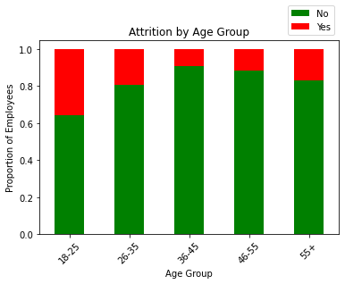
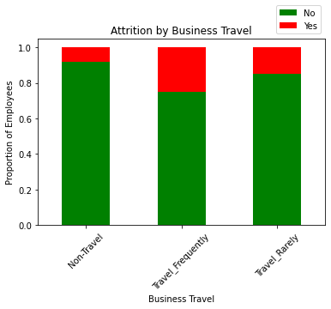
Figure 7: Attrition by Age Group
Figure 8: Attrition by Business Travel
Notes:
Initially, we postulated that the younger employees might exhibit a greater propensity to transition out of the company
Upon examining the data, as depicted in Figure 7, we observed that employees between the ages of 18 and 25 did show a tendency to leave the organization at a higher rate when compared to the older employees
Moving on to our second area of inquiry, we turned our attention to the potential correlation between the frequency of travel and employee retention
Here, our initial assumption was that those who engaged in more business travel might be more inclined to stay with the company, perhaps due to the variety and opportunities that travel can bring
However, the data presented a different narrative
As you can see in Figure 8, the reality was somewhat counterintuitive: employees who often traveled were more likely to leave the company

Slide 21
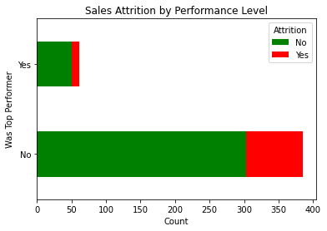
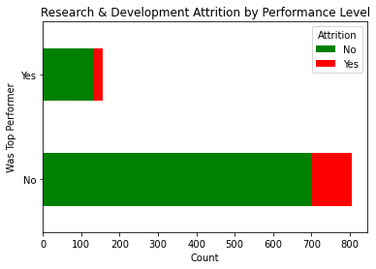
Figure 9: Sales Attrition by Performance Level
Figure 10: Research & Development Attrition by Performance Level
Notes:
Lastly, to determine if top performers were being retained, the analysis focused on those in Research & Development and Sales which can be seen in figures 9 and 10
The visualizations showed that approximately 84% of top performers remained with the company, supporting the hypothesis that top performers were indeed being retained effectively

Slide 22
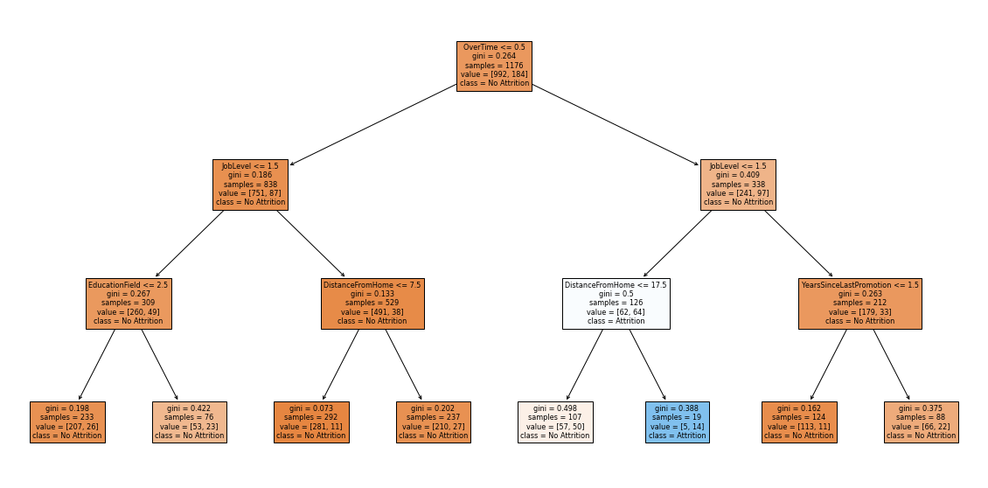
Figure 11: Predictive Model
Notes:
Figure 11 shows that a predictive model was developed, assigning 80% weight to certain features deemed most important
The model selected features with an importance score of at least 0.05, which included 'DistanceFromHome', 'PercentSalaryHike', 'JobLevel', 'NumCompaniesWorked', 'EducationField', 'YearsSinceLastPromotion', 'Attrition', and 'OverTime’
The model's accuracy was determined to be 0.826530612244898, marginally surpassing the baseline accuracy of 0.8197278911564626, which assumes no employee turnover
This slight improvement over the baseline suggests the model can provide insights into potential employee departures
Specifically, employees with 'OverTime' scores above 1.5, 'JobLevel' below 1.5, or 'DistanceFromHome' exceeding 17.5 are identified as having a higher likelihood of leaving

Slide 23
Real-World Application and Learning Outcomes
Real-World Challenges Preparation
The project honed practical data science skills such as data analysis, visualization, and predictive modeling, which are in high demand across various industries, ensuring readiness for professional application
It emphasized the importance of deriving and effectively communicating meaningful insights from data, a critical skill for decision-making in business, societal, and political contexts
Alignment of Program Objectives
Discussion of ethical considerations in data usage and HR decision-making
The project showcased expertise in data collection, storage, access, cleaning, pre-processing, and programming language use
Notes:
The project served as a hands-on experience in data science, offering me a set of skills that are directly applicable to the professional environment
I honed my abilities in data analysis, visualization, and predictive modeling, which are in high demand across a multitude of industries
A key component of my learning was the focus on ethical considerations, which has equipped me to handle real-world data with integrity and responsibility
I developed the critical skill of extracting meaningful insights from complex data and conveying these findings effectively, a competency that is essential for informed decision-making in various sectors, including business, society, and politics
Reflecting on the project's outcomes, it is clear that it aligns with the educational objectives of my program
I successfully achieved the goal of effectively collecting, storing, and retrieving data by utilizing advanced tools such as Python, Jupyter Notebook, and Google Colaboratory
The project involved working with a Kaggle HR analytics dataset, showcasing my ability to select and apply relevant technologies for efficient data management
Through my analysis, I provided strategies to mitigate employee turnover, offering valuable business insights
I conducted a thorough investigation into the factors that influence attrition rates and developed a predictive model to anticipate potential employee departures, demonstrating the creation of actionable insights for business applications
The project met another educational goal by applying visualization and predictive modeling techniques effectively
I utilized Python libraries to create informative visualizations, such as stacked bar charts, and developed a predictive model that achieved an accuracy rate exceeding the baseline
The project also highlighted my proficiency in Python, as I navigated detailed data cleaning, pre-processing, and analysis within this programming environment
Lastly, the project underscored the importance of ethical considerations in data science. I was careful to ensure that the analysis was not misused for hiring purposes and instead focused on enhancing the satisfaction of current employees, in line with the ethical standards set by our learning goals

Slide 24

IST 664: Natural Language Processing
Sentiment analysis on movie reviews
Notes:
In the course IST 664: Natural Language Processing led by Mr. Michael Larche, students demonstrated their skills in various aspects of linguistic analysis and natural language processing
Python was used to participate in a classification task, develop features, and conduct several experiments to determine the most suitable features for the selected data set
For the classification task of this course, I conducted sentiment analysis on movie reviews

Slide 25
IST 664: Natural Language Processing
Course Project Overview
The project centers on analyzing sentiment in movie reviews through Python, utilizing diverse preprocessing methods and classifiers
Python Implementation
Implementation of Python scripts for sentiment analysis, showcasing proficiency in NLP techniques and model training
Models Evaluation
Evaluated the effectiveness of different machine learning models in the context of natural language processing tasks
Notes:
I utilized a dataset from Kaggle, specifically designed for the Sentiment Analysis on Movie Reviews competition
The dataset is based on sentiment analysis research by Socher et al., which in turn was built upon Pang and Lee's movie review corpus from Rotten Tomatoes
It includes 156,060 phrases, each tagged with sentiments ranging from "negative" to "positive"
Post-competition, the training and some test data remain available, with the training set containing phrases, sentiment labels, and a SentenceId
The goal of the classification task was to accurately label each phrase's sentiment, with the main challenge being the selection of an appropriate subset for training
Sentiments were encoded numerically from 0 to 4 for processing efficiency.. With 0 being negative and 4 being positive

Slide 26
Classification Task and Results
Preprocessing Techniques
Utilized various preprocessing methods like tokenization, stop-word removal, and lemmatization to clean the text data before analysis and to enhance sentiment analysis accuracy
Feature Selection Methods
Implemented feature selection algorithms such as bag of words, bigrams, and unigrams to identify and extract relevant features for sentiment analysis
Classifier Performances
Evaluated the performance of classifiers like Naïve Bayes, random forest, and decision tree to determine the most effective model for sentiment analysis
Notes:
In my analysis, I applied a variety of preprocessing techniques to refine the data, which included breaking down text into tokens, filtering out unnecessary elements, and discarding words that didn't meet the alphanumeric criteria
I also utilized feature selection strategies such as the bag of words, bigrams, and unigrams.
I evaluated the performance of several classifiers, among them the Naïve Bayes and a selection of Sci-Kit Learner algorithms like the random forest and logistic regression
These were tested on different sets of features, both before and after preprocessing
The comparative results of these classifiers, considering the preprocessing factor, will be presented in the next slide
I also incorporated cross-validation in the study to bolster the reliability of my findings
I measured precision, recall, and F-measure scores to provide a thorough assessment of the classifiers' performance

Slide 27
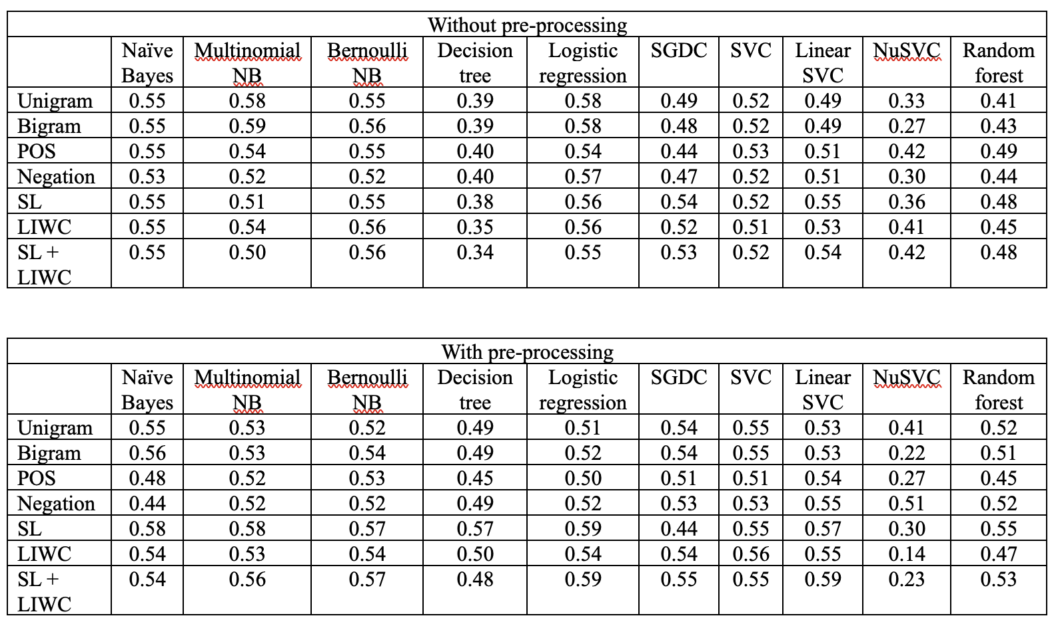
Figure 12: Comparison of Single-Fold Performances
Notes:
Figure 12 shows a side-by-side comparison of individual trial outcomes
The findings have consistently shown that incorporating preprocessing steps enhances the accuracy of the classification models
For example, when I employed a sentiment lexicon as a feature set, in conjunction with preprocessing, I observed a modest yet notable improvement over the basic unigram feature set
I established the Naïve Bayes algorithm, utilizing a unigram feature set without preprocessing, as the reference point and this model achieved a benchmark accuracy of 55%
Upon evaluating single-fold performances across various feature sets, it became apparent that the Support Vector Classifier (SVC) and NuSVC algorithms did not meet my performance expectations, as they demonstrated lower accuracy levels
Consequently, I decided to omit these classifiers from the subsequent cross-validation assessments

Slide 28
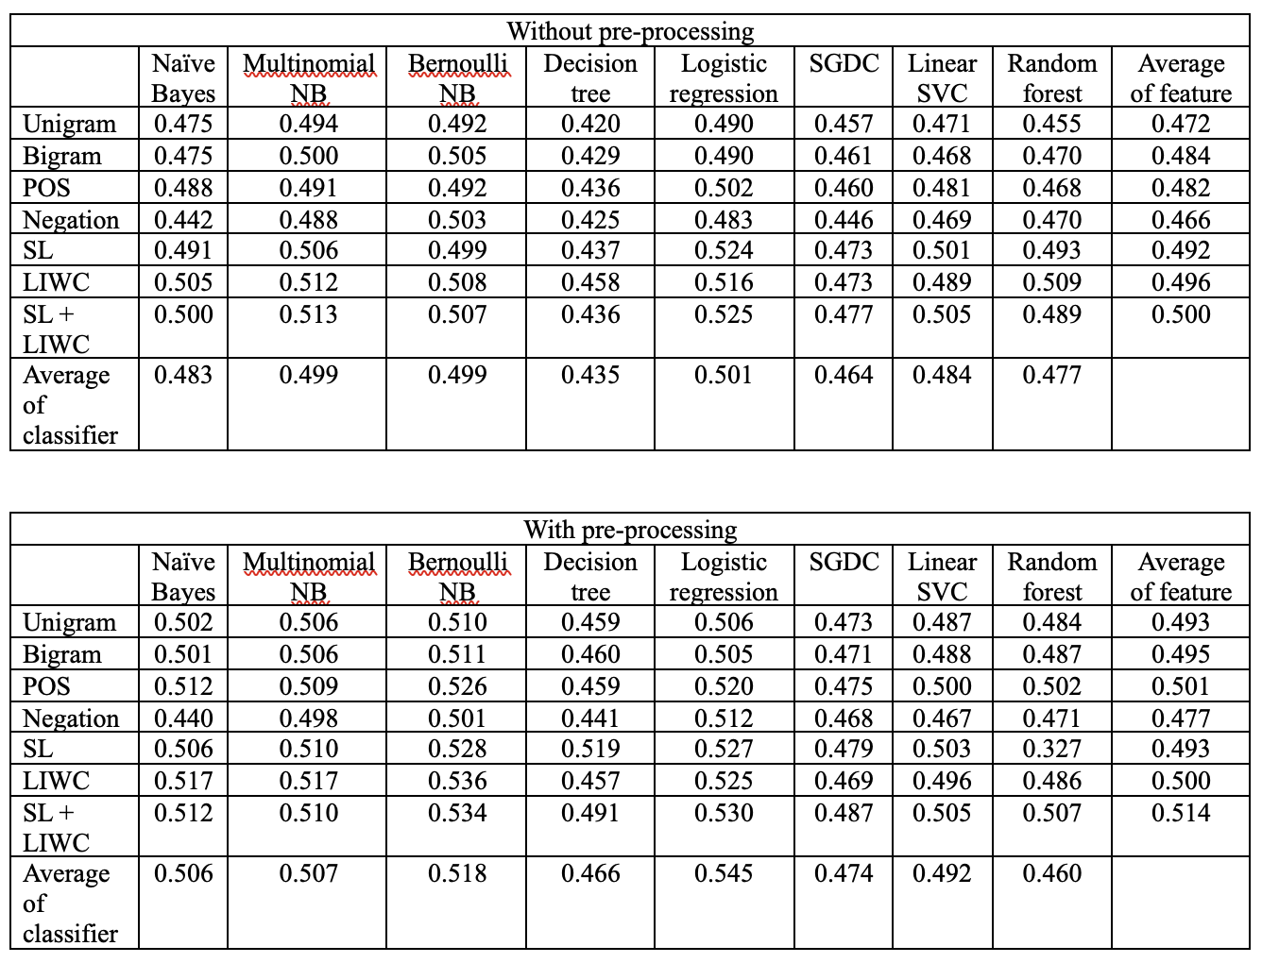
Figure 13: Summary of Mean Accuracies
Notes:
An extensive evaluation of mean accuracies for different classifiers and feature sets was performed, with comparisons made between preprocessed and non-preprocessed data, as illustrated in figure 13
The analysis revealed that the accuracy of classifiers using bigram features closely matched those using unigram features, indicating that bigrams may not provide a significant advantage in this context
Notably, classifiers that incorporated Part-of-Speech (POS) tagging and subjectivity features demonstrated a modest increase in accuracy compared to unigram features, suggesting these features may offer some benefit
In terms of classifier performance, Multinomial Naive Bayes, Bernoulli Naive Bayes, and logistic regression models showed higher accuracy rates compared to the standard Naive Bayes classifier

Slide 29
Real-World Application and Learning Outcomes
Real-World Challenges Preparation
Application of sentiment analysis demonstrates the practical value in understanding public sentiment from text data. Insights aid in decision-making and trend identification for various industries
Integration of machine learning techniques for sentiment analysis showcases the relevance of NLP in real-world applications. Understanding sentiment can drive targeted marketing strategies and customer engagement
Alignment of Program Objectives
The project demonstrates the ability to collect, store, and access data using Python for a classification task
The project applies visualization and predictive modeling techniques to analyze sentiment in movie reviews, showcasing the ability to create actionable insights across various contexts
Notes:
The task at hand provided a comprehensive platform for honing skills in data management, analysis, and predictive modeling
It was an opportunity to delve into the complexities of large data sets, develop and assess various predictive models, and learn the art of effectively communicating analytical results
A thorough examination of the task underscored the importance of preprocessing and feature selection in text classification
It became clear how different techniques and classifiers can significantly impact the accuracy of sentiment analysis, particularly within the context of movie reviews
Furthermore, the task offered a practical understanding of sentiment analysis and its potential to gauge public opinion
This understanding is incredibly versatile, with applications ranging from market research to the monitoring of social media trends
Upon reflection, it is apparent that this classification task has met several program objectives
The project involved the process of data collection, storage, and retrieval, aligning with our first learning goal. The data set utilized was sourced from Kaggle and consisted of movie review phrases, which we accessed and stored specifically for this task
Utilizing Python, I engaged in a classification task, crafted features, and conducted experiments to identify the most effective features for our data set. This hands-on experience with Python programming directly supports our fourth learning goal, which is to leverage programming languages to generate actionable insights
The project also achieved our second learning goal by creating actionable insights across various contexts. By assigning sentiment labels to each phrase, we were able to extract valuable insights into the overall sentiment of movie reviews, which can be particularly useful in a business context to gauge audience reception
Lastly, the project's application of visualization techniques and predictive modeling to generate actionable insights fulfilled our third learning goal. We visualized the outcomes of our classification efforts and tested multiple classifiers, including Naïve Bayes, and machine learning algorithms from Sci-Kit Learn such as Random Forest and Logistic Regression

Slide 30

Conclusion and Reflection
Program Learning Outcomes Achieved
Acquired expertise in data collection, analysis, and processing across varied datasets
Developed proficiency in various programming languages for data manipulation and visualization
Enhanced ability to generate insights and communicate complex data clearly
Applied ethical considerations in all data science practices
Technical Proficiency and Communication
Mastery of R and Python for data analysis. Effective communication of complex data insights
Skill in translating data findings into impactful narratives for diverse audiences
Commitment to upholding ethical standards in all aspects of data development and evaluation processes
Looking Towards the Future
Demonstrated readiness to apply data-driven solutions to real-world challenges
Prepared to make impactful contributions to the field of data science through acquired knowledge and skills
Gratitude towards Syracuse University for providing a platform for academic growth
Notes:
My journey to earning a Master of Science in Applied Data Science at Syracuse University has been a remarkable adventure
It's been a period of significant growth, where I've sharpened my data science skills and prepared myself to face the complex challenges of our data-centric world
The program challenged me with a variety of projects and courses that were both demanding and fulfilling
I've gained a deep understanding of SQL for database management, experimented with machine learning models, enhanced my Python programming for data analysis, and dived into natural language processing
I'm proud to have met all the learning outcomes set by the program
It's been a journey of acquiring the ability to manage data using the latest technologies, generating insights in various contexts, and applying visualization and predictive models for actionable insights
This experience has significantly improved my proficiency in programming languages like R and Python
I've learned to simplify complex data into clear narratives and have committed to ethical standards in data handling, focusing on fairness, transparency, and privacy.
As graduation approaches, I'm thankful for Syracuse University's inclusive approach and the comprehensive training it provided
This program has not only welcomed students from diverse backgrounds but also equipped us to confidently step into the data science field
I'm excited about the future and confident in the skills and insights I've gained
I look forward to contributing to the data science community and continuing my professional development in this ever-evolving field
My portfolio is a testament to my academic journey, showcasing the skills and knowledge I've acquired. It reflects my readiness to tackle data-driven challenges and my commitment to continuous learning and professional growth in applied data science

Slide 31

Thank you!
GitHub: https://github.com/bthoma16/IST-782-Applied-Data-Science-Portfolio
LinkedIn: https://www.linkedin.com/in/blessy-thomas-bthomasca24/
Notes:
That is the end of my portfolio
Thank you for watching
You can find the link to my GitHub portfolio page here where you will be able to see the referenced courses and projects I discussed in my portfolio
And feel free to connect with me on LinkedIn!

